Slide 1
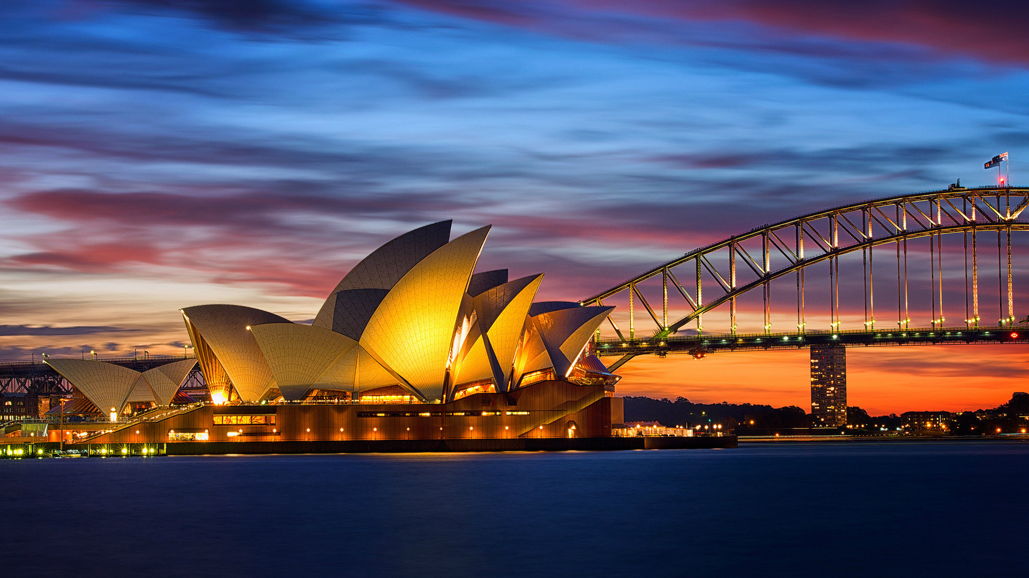
Australia & Facts
Made by Muhammad Arsalan Grade 11-O

Slide 2
Brief
Australia, officially the Commonwealth of Australia, is a sovereign country comprising the mainland of the Australian continent, the island of Tasmania, and numerous smaller islands. With an area of 7,617,930 square kilometers (2,941,300 sq mi), Australia is the largest country by area in Oceania and the world's sixth-largest country. Australia is the oldest, flattest, and driest inhabited continent, with the least fertile soils. It is a megadiverse country, and its size gives it a wide variety of landscapes and climates, with deserts in the center, tropical rainforests in the north-east, and mountain ranges in the south-east.

Slide 3
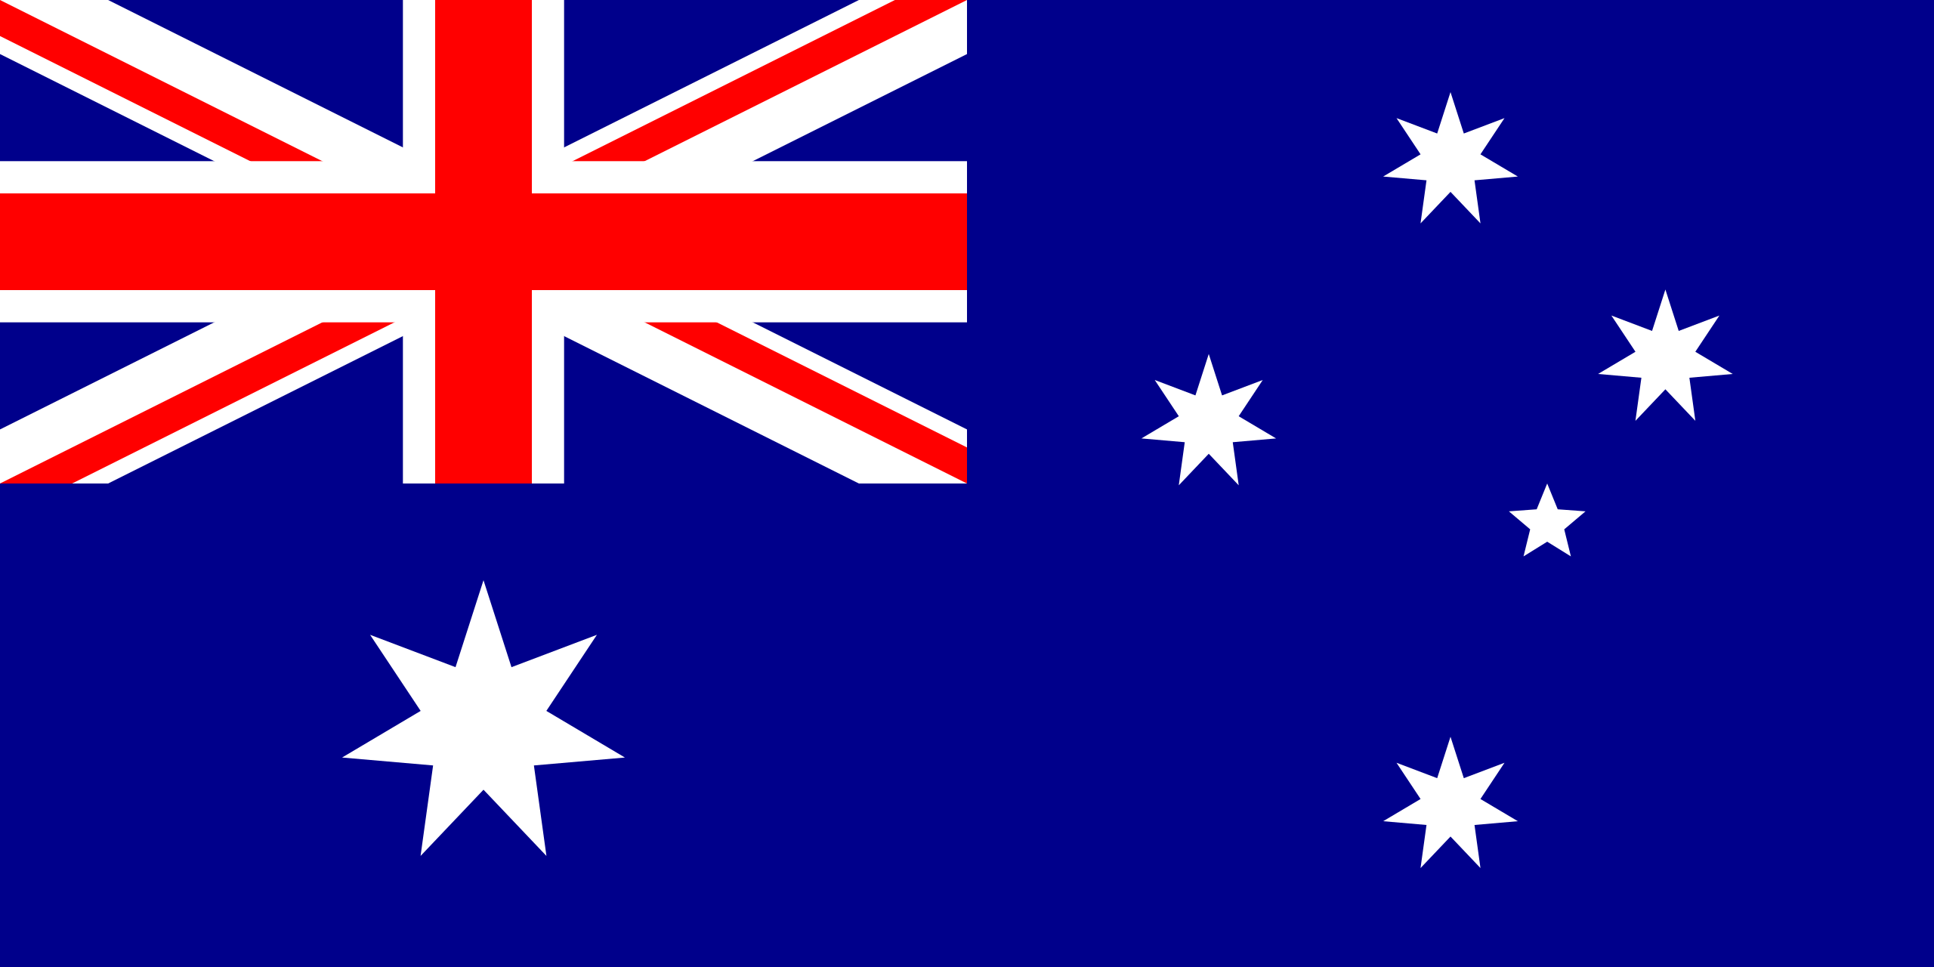
Flag
The Flag of Australia.

Slide 4
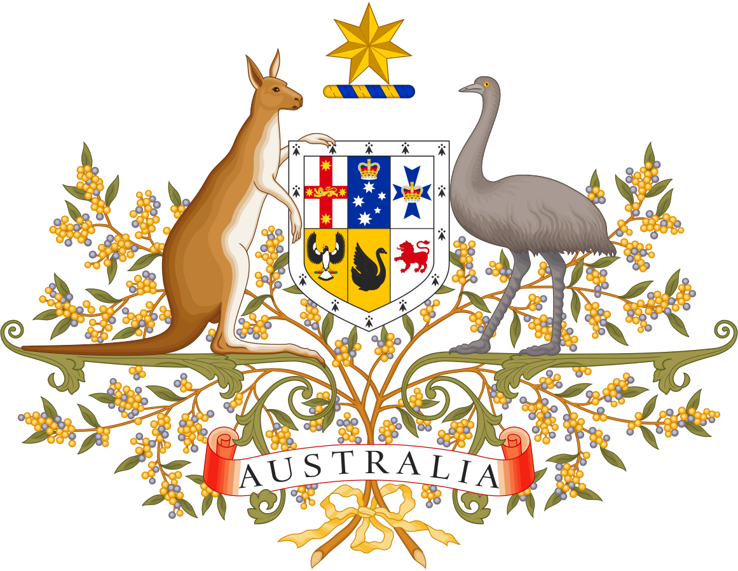
Coat of Arms
The Coat of Arms Emblem of Australia.

Slide 5
History
People first arrived on the Australian mainland by sea from Maritime Southeast Asia between 50,000 and 65,000 years ago, and penetrated to all parts of the continent, from the rainforests in the north, the deserts of the center, and the sub-Antarctic islands of Tasmania and Bass Strait. The artistic, musical and spiritual traditions they established are among the longest surviving such traditions in human history.
The first Torres Strait Islanders - ethnically and culturally distinct from the Aboriginal people - arrived from what is now Papua New Guinea around 2,500 years ago, and settled in the islands of the Torres Strait and the Cape York Peninsula forming the northern tip of the Australian landmass.

Slide 6
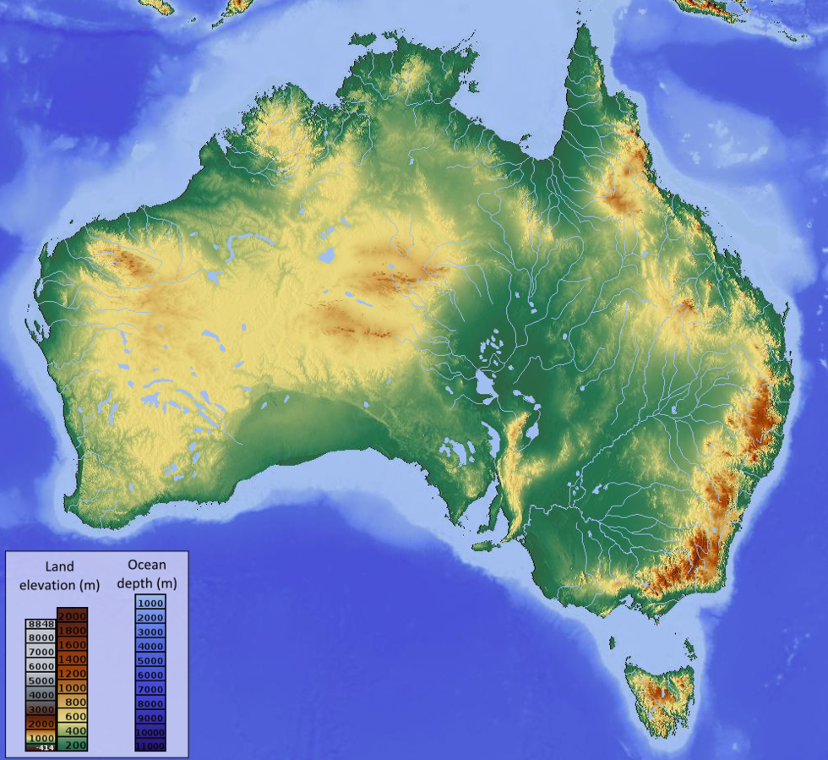
Map
The Map of Australia.

Slide 7
General Geography
Surrounded by the Indian and Pacific oceans, Australia is separated from Asia by the Arafura and Timor seas, with the Coral Sea lying off the Queensland coast, and the Tasman Sea lying between Australia and New Zealand. The world's smallest continent and sixth largest country by total area, Australia—owing to its size and isolation—is often dubbed the "island continent" and is sometimes considered the world's largest island. Australia has 34,218 km (21,262 mi) of coastline (excluding all offshore islands), and claims an extensive Exclusive Economic Zone of 8,148,250 square kilometers (3,146,060 sq mi). This exclusive economic zone does not include the Australian Antarctic Territory.

Slide 8
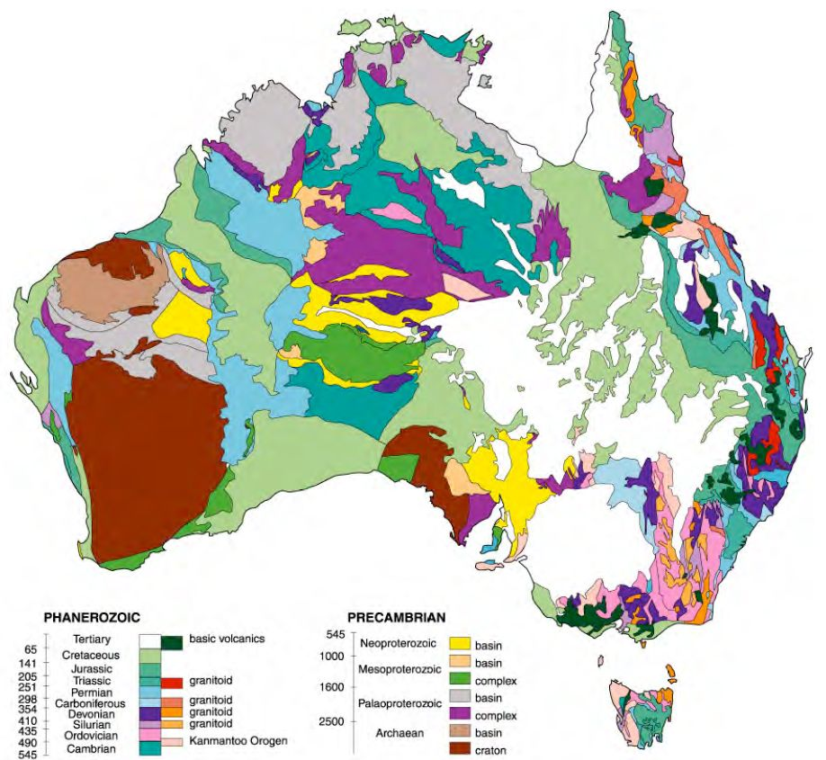
GEOLOGY
The Map of Australia.

Slide 9
Geology
Lying on the Indo-Australian Plate, the mainland of Australia is the lowest and most primordial landmass on Earth with a relatively stable geological history. The landmass includes virtually all known rock types and from all geological time periods spanning over 3.8 billion years of the Earth's history. The Pilbara Craton is one of only two pristine Archaean 3.6–2.7 Ga (billion years ago) crusts identified on the Earth.
Having been part of all major supercontinents, the Australian continent began to form after the breakup of Gondwana in the Permian, with the separation of the continental landmass from the African continent and Indian subcontinent. It separated from Antarctica over a prolonged period beginning in the Permian and continuing through to the Cretaceous. When the last glacial period ended in about 10,000 BC, rising sea levels formed Bass Strait, separating Tasmania from the mainland. Then between about 8,000 and 6,500 BC, the lowlands in the north were flooded by the sea, separating New Guinea, the Aru Islands, and the mainland of Australia. The Australian continent is moving toward Eurasia at the rate of 6 to 7 centimeters a year.

Slide 10
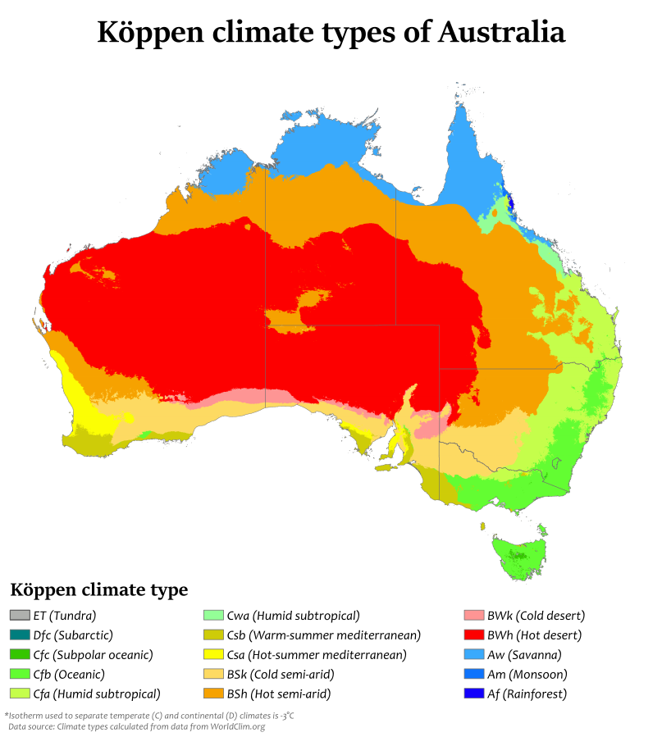
Climate
The Climate of Australia.

Slide 11
Climate
The climate of Australia is significantly influenced by ocean currents, including the Indian Ocean Dipole and the El Niño–Southern Oscillation, which is correlated with periodic drought, and the seasonal tropical low-pressure system that produces cyclones in northern Australia. These factors cause rainfall to vary markedly from year to year. Much of the northern part of the country has a tropical, predominantly summer-rainfall (monsoon). The south-west corner of the country has a Mediterranean climate. The south-east ranges from oceanic (Tasmania and coastal Victoria) to humid subtropical (upper half of New South Wales), with the highlands featuring alpine and subpolar oceanic climates. The interior is arid to semi-arid.
Driven by climate change, average temperatures have risen more than 1°C since 1960. Associated changes in rainfall patterns and climate extremes exacerbate existing issues such as drought and bushfires. 2019 was Australia's warmest recorded year, and the 2019–2020 bushfire season was the country's worst on record. Australia's greenhouse gas emissions per capita are among the highest in the world.

Slide 12
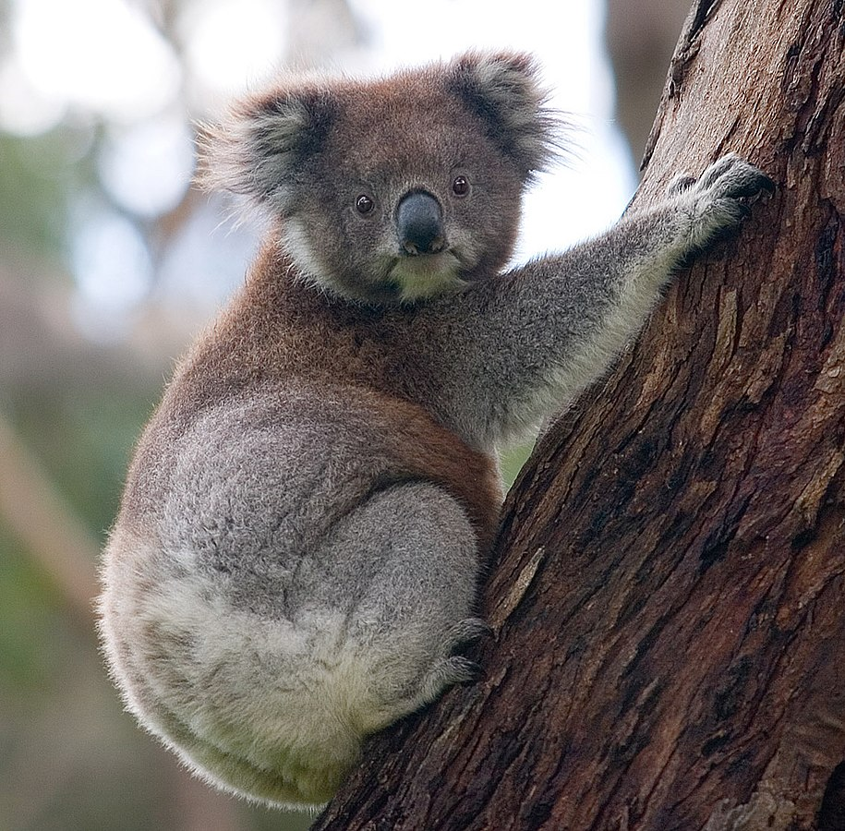
Biodiversity
The Biodiversity of Australia.

Slide 13
Biodiversity
Although most of Australia is semi-arid or desert, the continent includes a diverse range of habitats from alpine heaths to tropical rainforests. Fungi typify that diversity—an estimated 250,000 species—of which only 5% have been described—occur in Australia. Because of the continent's great age, extremely variable weather patterns, and long-term geographic isolation, much of Australia's biota is unique. About 85% of flowering plants, 84% of mammals, more than 45% of birds, and 89% of in-shore, temperate-zone fish are endemic. Australia has at least 755 species of reptile, more than any other country in the world. Besides Antarctica, Australia is the only continent that developed without feline species. Feral cats may have been introduced in the 17th century by Dutch shipwrecks, and later in the 18th century by European settlers. They are now considered a major factor in the decline and extinction of many vulnerable and endangered native species. Australia is also one of 17 megadiverse countries.
Australian forests are mostly made up of evergreen species, particularly eucalyptus trees in the less arid regions; wattles replace them as the dominant species in drier regions and deserts. Among well-known Australian animals are the monotremes (the platypus and echidna); a host of marsupials, including the kangaroo, koala, and wombat, and birds such as the emu and the kookaburra. Australia is home to many dangerous animals including some of the most venomous snakes in the world. The dingo was introduced by Austronesian people who traded with Indigenous Australians around 3000 BCE. Many animal and plant species became extinct soon after first human settlement, including the Australian megafauna; others have disappeared since European settlement, among them the thylacine.

Slide 14
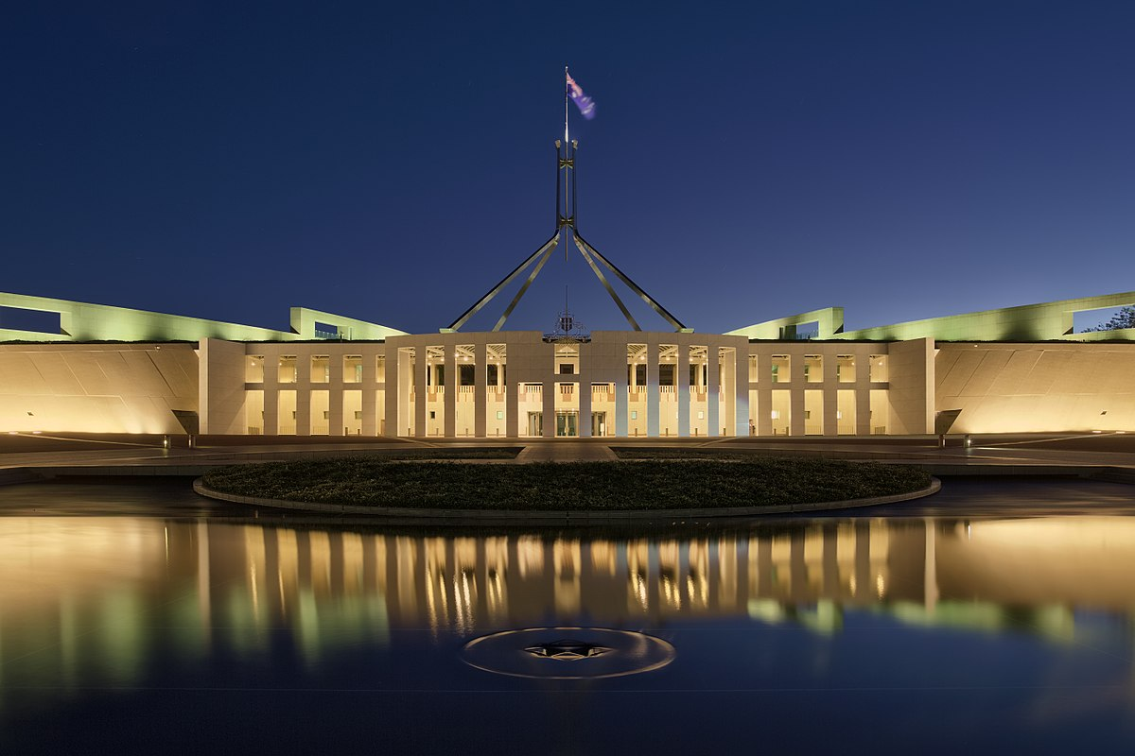
Politics
The Government and Politics of Australia.

Slide 15
Government and politics
Australia is a federal parliamentary constitutional monarchy. The country has maintained a stable liberal democratic political system under its constitution, which is one of the world's oldest, since Federation in 1901. It is also one of the world's oldest federations, in which power is divided between the federal and state and territorial governments. The Australian system of government combines elements derived from the political systems of the United Kingdom (a fused executive, constitutional monarchy and strong party discipline) and the United States (federalism, a written constitution and strong bicameralism with an elected upper house), along with distinctive indigenous features.
Elizabeth II reigns as Queen of Australia and is represented in Australia by the governor-general at the federal level and by the governors at the state level, who by convention act on the advice of her ministers. Thus, in practice the governor-general acts as a legal figurehead for the actions of the prime minister and the Federal Executive Council. The governor-general does have extraordinary reserve powers which may be exercised outside the prime minister's request in rare and limited circumstances, the most notable exercise of which was the dismissal of the Whitlam Government in the constitutional crisis of 1975.

Slide 16
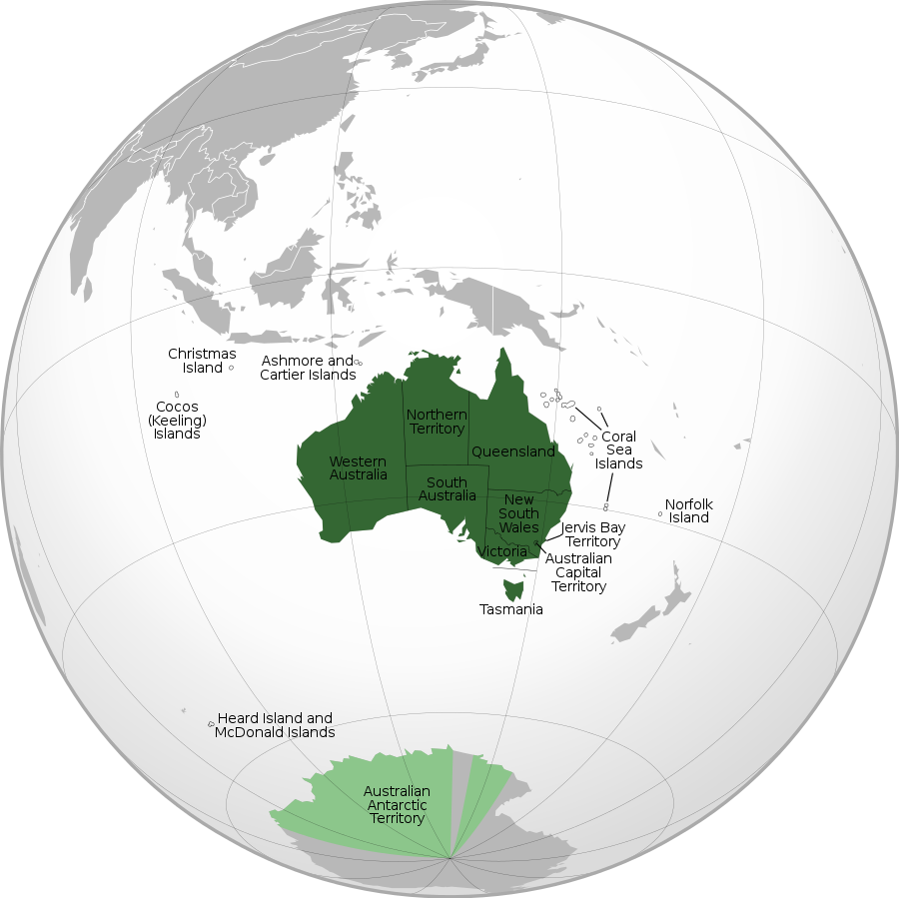
States
The states and territories of Australia.

Slide 17
States and territories
Australia has six states — New South Wales (NSW), Queensland (QLD), South Australia (SA), Tasmania (TAS), Victoria (VIC) and Western Australia (WA) — and three mainland territories—the Australian Capital Territory (ACT), the Northern Territory (NT), and the Jervis Bay Territory (JBT). In most respects, the ACT and NT function as states, except that the Commonwealth Parliament has the power to modify or repeal any legislation passed by the territory parliaments.
Under the constitution, the states essentially have plenary legislative power to legislate on any subject, whereas the Commonwealth (federal) Parliament may legislate only within the subject areas enumerated under section 51. For example, state parliaments have the power to legislate with respect to education, criminal law and state police, health, transport, and local government, but the Commonwealth Parliament does not have any specific power to legislate in these areas. However, Commonwealth laws prevail over state laws to the extent of the inconsistency.

Slide 18
Military
Australia's armed forces — the Australian Defense Force (ADF) — comprise the Royal Australian Navy (RAN), the Australian Army and the Royal Australian Air Force (RAAF), in total numbering 81,214 personnel (including 57,982 regulars and 23,232 reservists) as of November 2015. The titular role of Commander-in-Chief is vested in the Governor-General, who appoints a Chief of the Defense Force from one of the armed services on the advice of the government. In a diarchy, the Chief of the Defense Force serves as co-chairman of the Defense Committee, conjointly with the Secretary of Defense, in the command and control of the Australian Defense Organization.
In the 2016–2017 budget, defense spending comprised 2% of GDP, representing the world's 12th largest defense budget. Australia has been involved in United Nations and regional peacekeeping, disaster relief, as well as armed conflicts from the First World War onwards.

Slide 19
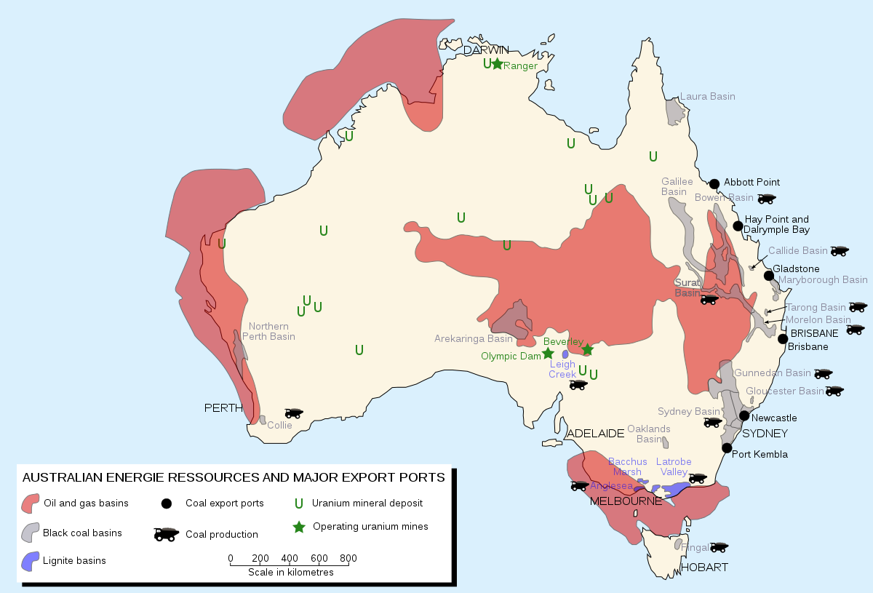
Economy
The economy of Australia.

Slide 20
Economy
A wealthy country, Australia has a market economy, a high GDP per capita, and a relatively low rate of poverty. In terms of average wealth, Australia ranked second in the world after Switzerland from 2013 until 2018. In 2018, Australia overtook Switzerland and became the country with the highest average wealth. Australia's relative poverty rate is 13.6%. It was identified by the Credit Suisse Research Institute as the nation with the highest median wealth in the world and the second-highest average wealth per adult in 2013.
The Australian dollar is the currency for the nation, including Christmas Island, Cocos (Keeling) Islands, and Norfolk Island, as well as the independent Pacific Island states of Kiribati, Nauru, and Tuvalu. With the 2006 merger of the Australian Stock Exchange and the Sydney Futures Exchange, the Australian Securities Exchange became the ninth largest in the world.

Slide 21
Energy
In 2003, Australia's energy sources were coal (58.4%), hydropower (19.1%), natural gas (13.5%), liquid/gas fossil fuel-switching plants (5.4%), oil (2.9%), and other renewable resources like wind power, solar energy, and bioenergy (0.7%). During the 21st century, Australia has been trending to generate more energy using renewable resources and less energy using fossil fuels. In 2020, Australia used coal for 62% of all energy (3.6% increase compared to 2013), wind power for 9.9% (9.5% increase), natural gas for 9.9% (3.6% decrease), solar power for 9.9% (9.8% increase), hydropower for 6.4% (12.7% decrease), bioenergy for 1.4% (1.2% increase), and other sources like oil and waste coal mine gas for 0.5%.
In August 2009, Australia's government set a goal to achieve 20% of all energy in the country from renewable sources by 2020. They achieved this goal, as renewable resources accounted for 27.7% of Australia's energy in 2020.

Slide 22
Demographics
Australia has an average population density of 3.4 persons per square kilometer of total land area, which makes it one of the most sparsely populated countries in the world. The population is heavily concentrated on the east coast, and in particular in the south-eastern region between South East Queensland to the north-east and Adelaide to the south-west.
Australia is highly urbanized, with 67% of the population living in the Greater Capital City Statistical Areas (metropolitan areas of the state and mainland territorial capital cities) in 2018. Metropolitan areas with more than one million inhabitants are Sydney, Melbourne, Brisbane, Perth and Adelaide.
In common with many other developed countries, Australia is experiencing a demographic shift towards an older population, with more retirees and fewer people of working age. In 2018 the average age of the Australian population was 38.8 years. In 2015, 2.15% of the Australian population lived overseas, one of the lowest proportions worldwide.

Slide 23
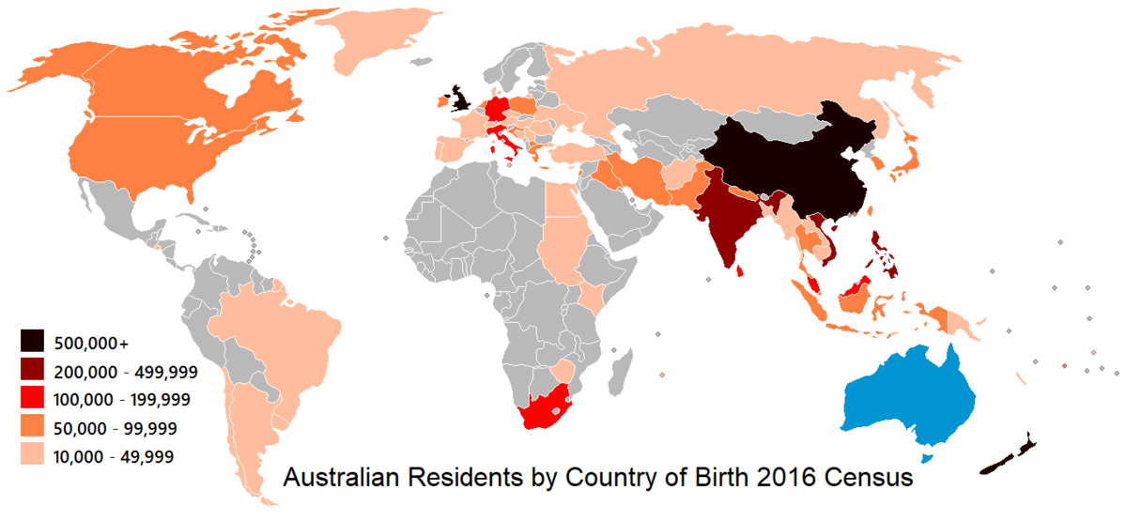
Immigration
The ancestry and immigration of Australia.

Slide 24
Ancestry and immigration
Between 1788 and the Second World War, the vast majority of settlers and immigrants came from the British Isles (principally England, Ireland and Scotland), although there was significant immigration from China and Germany during the 19th century. In the decades immediately following the Second World War, Australia received a large wave of immigration from across Europe, with many more immigrants arriving from Southern and Eastern Europe than in previous decades. Since the end of the White Australia policy in 1973, Australia has pursued an official policy of multiculturalism, and there has been a large and continuing wave of immigration from across the world, with Asia being the largest source of immigrants in the 21st century.
Today, Australia has the world's eighth-largest immigrant population, with immigrants accounting for 30% of the population, the highest proportion among major Western nations. 160,323 permanent immigrants were admitted to Australia in 2018–2019 (excluding refugees), whilst there was a net population gain of 239,600 people from all permanent and temporary immigration in that year. The majority of immigrants are skilled, but the immigration program includes categories for family members and refugees. In 2020, the largest foreign-born populations were those born in England (3.8%), India (2.8%), Mainland China (2.5%), New Zealand (2.2%), the Philippines (1.2%) and Vietnam (1.1%).

Slide 25
Language
Although Australia has no official language, English is the de facto national language. Australian English is a major variety of the language with a distinctive accent and lexicon, and differs slightly from other varieties of English in grammar and spelling. General Australian serves as the standard dialect.
According to the 2016 census, English is the only language spoken in the home for 72.7% of the population. The next most common languages spoken at home are Mandarin (2.5%), Arabic (1.4%), Cantonese (1.2%), Vietnamese (1.2%) and Italian (1.2%). Over 250 Indigenous Australian languages are thought to have existed at the time of first European contact, of which fewer than twenty are still in daily use by all age groups. About 110 others are spoken exclusively by older people. At the time of the 2006 census, 52,000 Indigenous Australians, representing 12% of the Indigenous population, reported that they spoke an Indigenous language at home. Australia has a sign language known as Auslan, which is the main language of about 10,112 deaf people who reported that they use Auslan language at home in the 2016 census.

Slide 26
Religion
Australia has no state religion; Section 116 of the Australian Constitution prohibits the federal government from making any law to establish any religion, impose any religious observance, or prohibit the free exercise of any religion. In the 2016 census, 52.1% of Australians were counted as Christian, including 22.6% as Catholic and 13.3% as Anglican; 30.1% of the population reported having "no religion"; 8.2% identify with non-Christian religions, the largest of these being Islam (2.6%), followed by Buddhism (2.4%), Hinduism (1.9%), Sikhism (0.5%) and Judaism (0.4%). The remaining 9.7% of the population did not provide an adequate answer. Those who reported having no religion increased from 19% in 2006 to 22% in 2011 to 30.1% in 2016.Australia has one of the lowest levels of religious adherence in the world. In 2018, 13% of women and 10% of men reported attending church at least weekly.

Slide 27
Health
Australia's life expectancy is the fourth highest in the world for males and the third highest for females. Life expectancy in Australia in 2014–2016 was 80.4 years for males and 84.6 years for females. Australia has the highest rates of skin cancer in the world, while cigarette smoking is the largest preventable cause of death and disease, responsible for 7.8% of the total mortality and disease. Ranked second in preventable causes is hypertension at 7.6%, with obesity third at 7.5%. Australia ranks 35th in the world and near the top of developed nations for its proportion of obese adults and nearly two thirds (63%) of its adult population is either overweight or obese.
Total expenditure on health (including private sector spending) is around 9.8% of GDP. Australia introduced universal health care in 1975. Known as Medicare, it is now nominally funded by an income tax surcharge known as the Medicare levy, currently at 2%. The states manage hospitals and attached outpatient services, while the Commonwealth funds the Pharmaceutical Benefits Scheme (subsidizing the costs of medicines) and general practice.
During the COVID-19 pandemic Australia had one of the most restrictive quarantine policies, resulting in one of the lowest death rates worldwide.

Slide 28
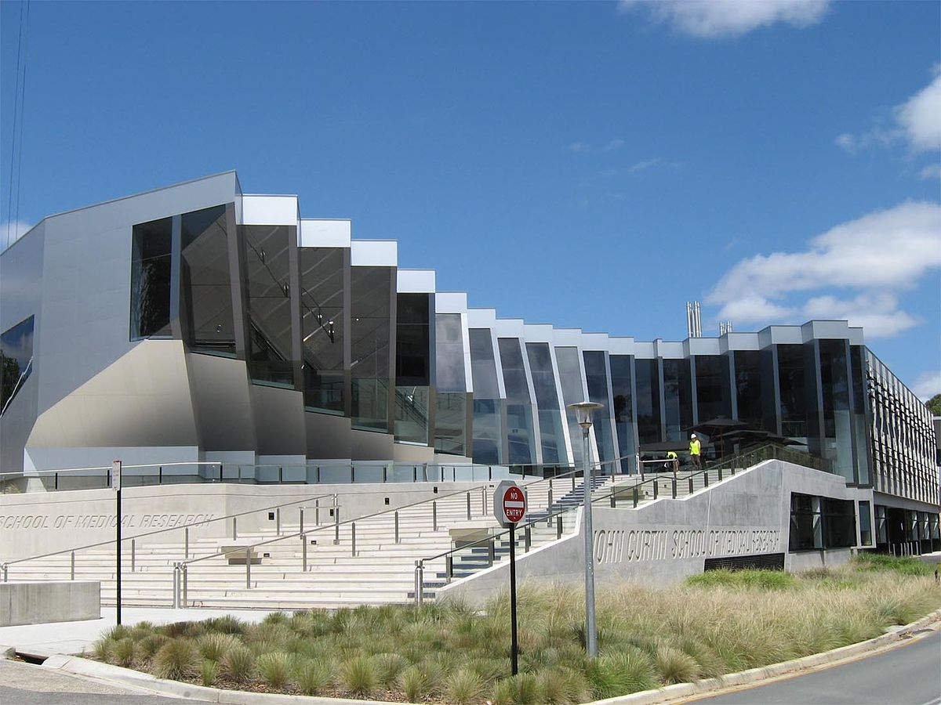
Education
The education of Australia.

Slide 29
Education
School attendance, or registration for home schooling, is compulsory throughout Australia. Education is the responsibility of the individual states and territories so the rules vary between states, but in general children are required to attend school from the age of about 5 until about 16. In some states (e.g., Western Australia, the Northern Territory and New South Wales), children aged 16–17 are required to either attend school or participate in vocational training, such as an apprenticeship.
Australia has an adult literacy rate that was estimated to be 99% in 2003. However, a 2011–2012 report for the Australian Bureau of Statistics reported that Tasmania has a literacy and numeracy rate of only 50%.
Australia has 37 government-funded universities and three private universities, as well as a number of other specialist institutions that provide approved courses at the higher education level. The OECD places Australia among the most expensive nations to attend university. There is a state-based system of vocational training, known as TAFE, and many trades conduct apprenticeships for training new tradespeople. About 58% of Australians aged from 25 to 64 have vocational or tertiary qualifications, and the tertiary graduation rate of 49% is the highest among OECD countries. 30.9% of Australia's population has attained a higher education qualification, which is among the highest percentages in the world.

Slide 30
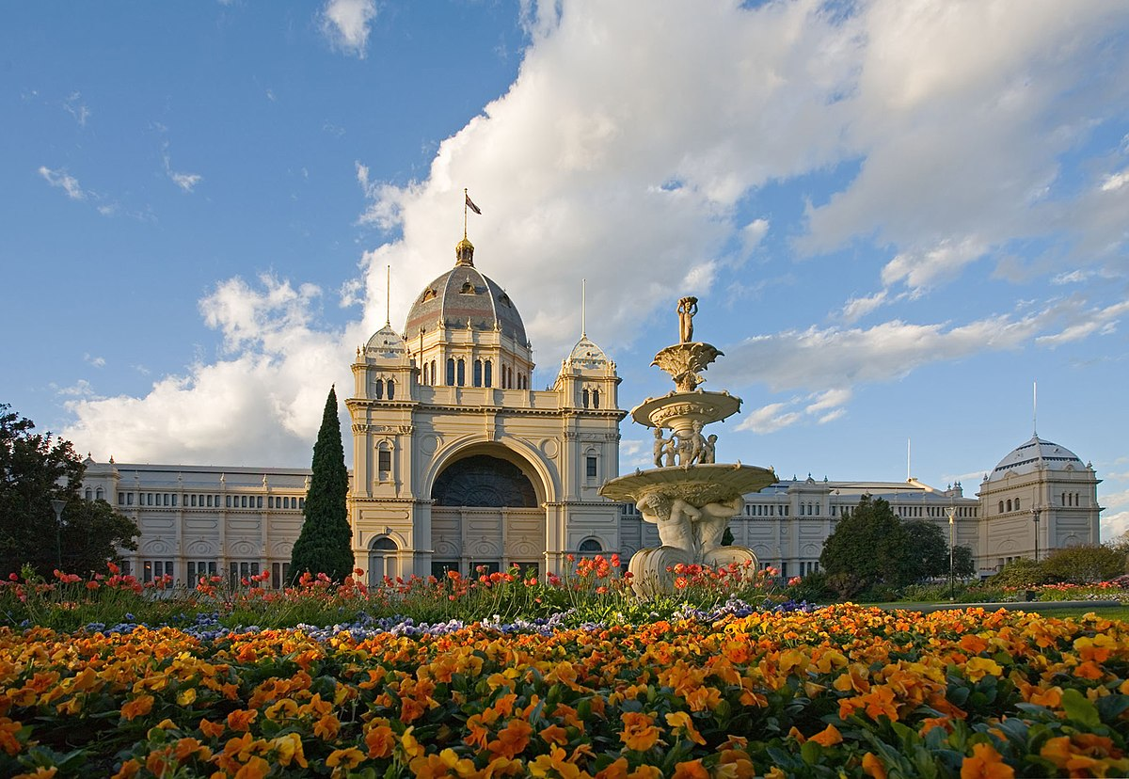
Culture
The culture of Australia.

Slide 31
Culture
Australia is home to a diversity of cultures, a result of its history of immigration. Since 1788, Australian culture has primarily been a Western culture strongly influenced by early Anglo-Celtic settlers. Other influences include Australian Aboriginal culture, the traditions brought to the country by waves of immigration from around the world, and the culture of the United States. The cultural divergence and evolution that has occurred over the centuries since European settlement has resulted in a distinctive Australian culture.

Slide 32
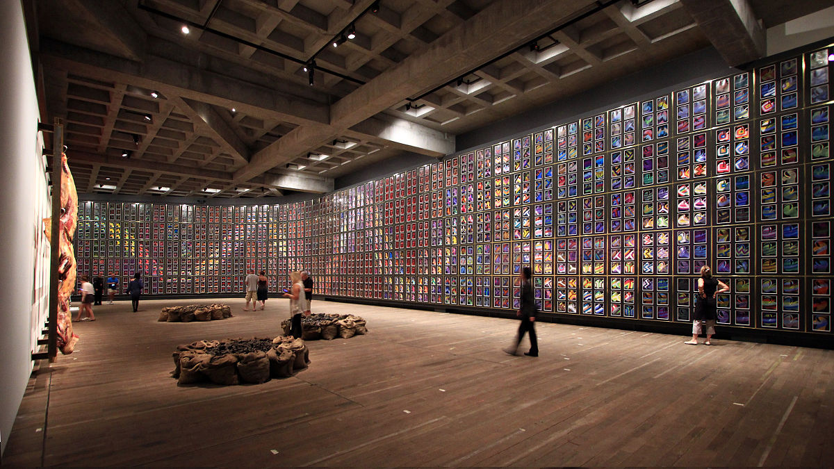
Arts
The art of Australia.

Slide 33
Arts
Australia has over 100,000 Aboriginal rock art sites, and traditional designs, patterns and stories infuse contemporary Indigenous Australian art, "the last great art movement of the 20th century" according to critic Robert Hughes; its exponents include Emily Kame Kngwarreye. Early colonial artists showed a fascination with the unfamiliar land. The impressionistic works of Arthur Streeton, Tom Roberts and other members of the 19th-century Heidelberg School—the first "distinctively Australian" movement in Western art—gave expression to nationalist sentiments in the lead-up to Federation. While the school remained influential into the 1900s, modernists such as Margaret Preston, and, later, Sidney Nolan and Arthur Boyd, explored new artistic trends. The landscape remained a central subject matter for Fred Williams, Brett Whitely and other post-war artists whose works, eclectic in style yet uniquely Australian, moved between the figurative and the abstract. The national and state galleries maintain collections of local and international art. Australia has one of the world's highest attendances of art galleries and museums per head of population.

Slide 34
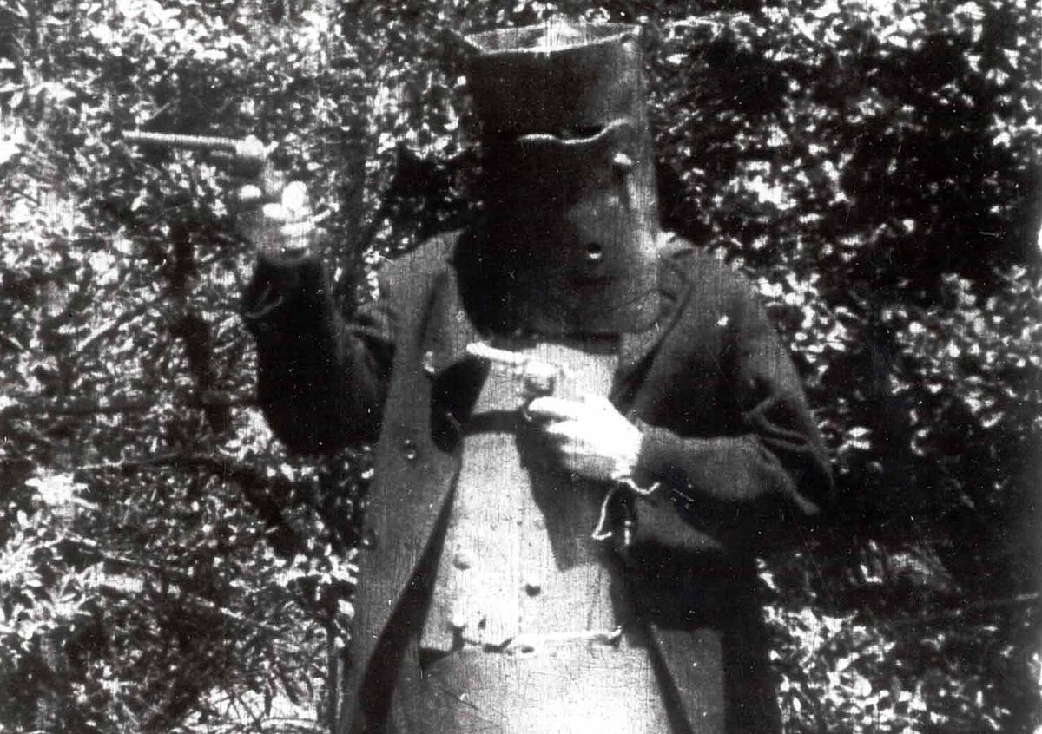
Media
The media of Australia.

Slide 35
Media
The Story of the Kelly Gang (1906), the world's first feature-length narrative film, spurred a boom in Australian cinema during the silent film era. After World War I, Hollywood monopolized the industry, and by the 1960s Australian film production had effectively ceased. With the benefit of government support, the Australian New Wave of the 1970s brought provocative and successful films, many exploring themes of national identity, such as Wake in Fright and Gallipoli, while Crocodile Dundee and the Ozploitation movement's Mad Max series became international blockbusters. In a film market flooded with foreign content, Australian films delivered a 7.7% share of the local box office in 2015. The AACTAs are Australia's premier film and television awards, and notable Academy Award winners from Australia include Geoffrey Rush, Nicole Kidman, Cate Blanchett and Heath Ledger.
Australia has two public broadcasters (the Australian Broadcasting Corporation and the multicultural Special Broadcasting Service), three commercial television networks, several pay-tv services, and numerous public, non-profit television and radio stations. Each major city has at least one daily newspaper, and there are two national daily newspapers, The Australian and The Australian Financial Review. In 2020, Reporters Without Borders placed Australia 25th on a list of 180 countries ranked by press freedom, behind New Zealand (8th) but ahead of the United Kingdom (33rd) and United States (44th). This relatively low ranking is primarily because of the limited diversity of commercial media ownership in Australia; most print media are under the control of News Corporation and Nine Entertainment Co.

Slide 36

Cuisine
The Cuisine of Australia.

Slide 37
Cuisine
Most Indigenous Australian groups subsisted on a simple hunter-gatherer diet of native fauna and flora, otherwise called bush tucker. The first settlers introduced British and Irish cuisine to the continent. This influence is seen in the enduring popularity of several British dishes such as fish and chips, and in quintessential Australian dishes such as the Australian meat pie, which is derived from the British steak pie. Post-war immigration transformed Australian cuisine. For instance, Southern European migrants helped to build a thriving Australian coffee culture which gave rise to Australian coffee drinks such as the flat white, while East Asian migration led to dishes such as the Cantonese-influenced dim sim and Chiko Roll, as well as a distinct Australian Chinese cuisine. Sausage sizzles, pavlovas, lamingtons, meat pies, Vegemite and Anzac biscuits are regarded as iconic Australian foods.
Australia is a leading exporter and consumer of wine. Australian wine is produced mainly in the southern, cooler parts of the country. The nation also ranks highly in beer consumption, with each state and territory hosting numerous breweries. Australia is also known for its cafe and coffee culture in urban centers.

Slide 38
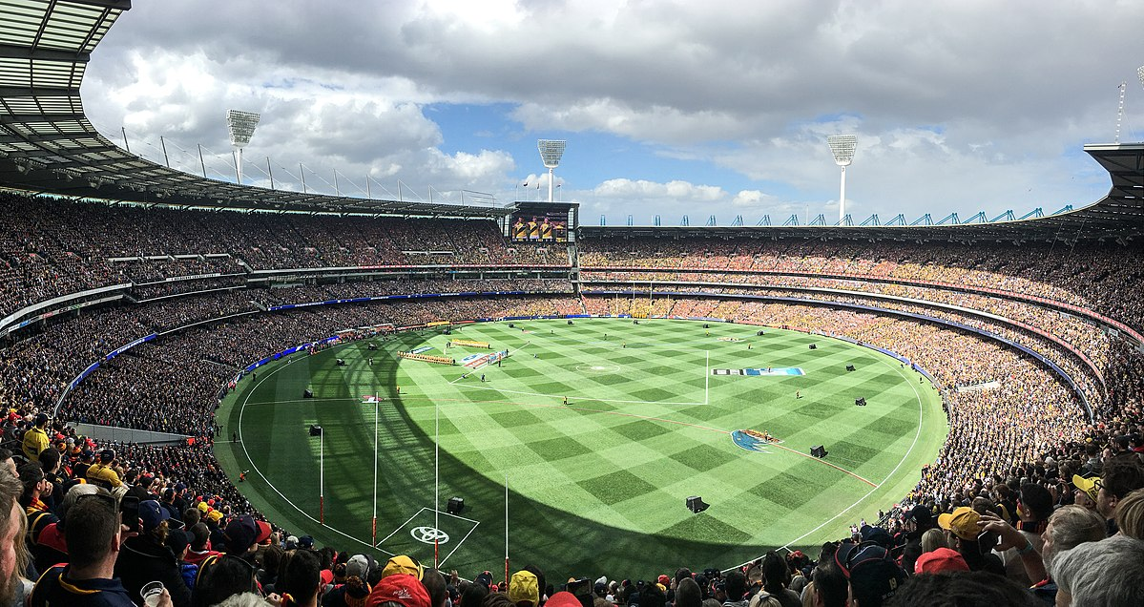
Sport
The sports of Australia.

Slide 39
Sport and recreation
Cricket and football are the predominate sports in Australia during the summer and winter months, respectively. Australia is unique in that it has professional leagues for four football codes. Originating in Melbourne in the 1850s, Australian rules football is the most popular code in all states except New South Wales and Queensland, where rugby league holds sway, followed by rugby union; the imaginary border separating areas where Australian rules football dominates from those were the two rugby codes prevail is known as the Barassi Line. Soccer, while ranked fourth in popularity and resources, has the highest overall participation rates. Cricket is popular across all borders and has been regarded by many Australians as the national sport. The Australian national cricket team competed against England in the first Test match (1877) and the first One Day International (1971), and against New Zealand in the first Twenty20 International (2004), winning all three games. It has also participated in every edition of the Cricket World Cup, winning the tournament a record five times.
Australia is also notable for water-based sports, such as swimming and surfing. The surf lifesaving movement originated in Australia, and the volunteer lifesaver is one of the country's icons. Nationally, other popular sports include horse racing, basketball, and motor racing. The annual Melbourne Cup horse race and the Sydney to Hobart yacht race attract intense interest. In 2016, the Australian Sports Commission revealed that swimming, cycling and soccer are the three most popular participation sports.

Slide 40
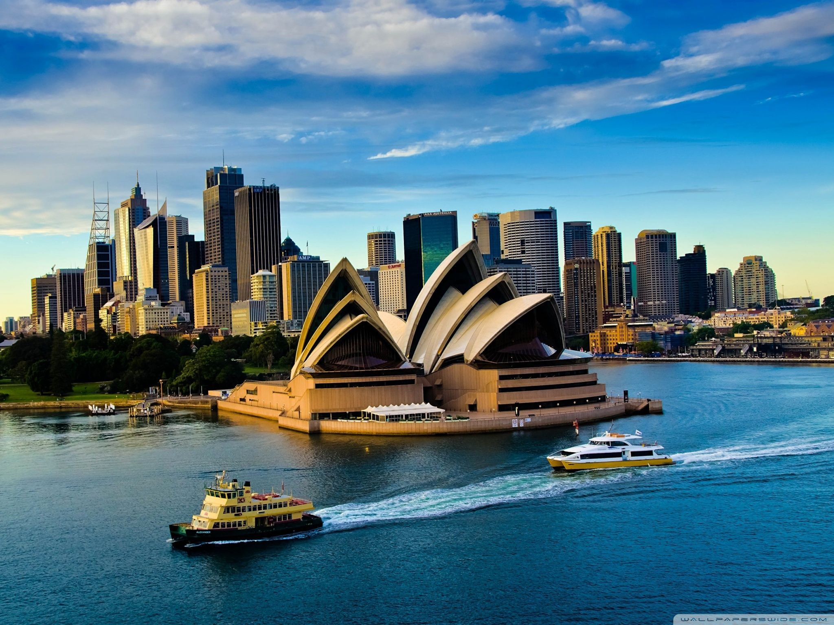
Thank You!
Make sure to ride safe to Australia!
And come to the safe https://jis-grade11.web.app/

